Slide 1
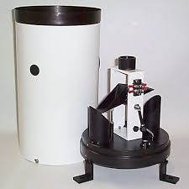
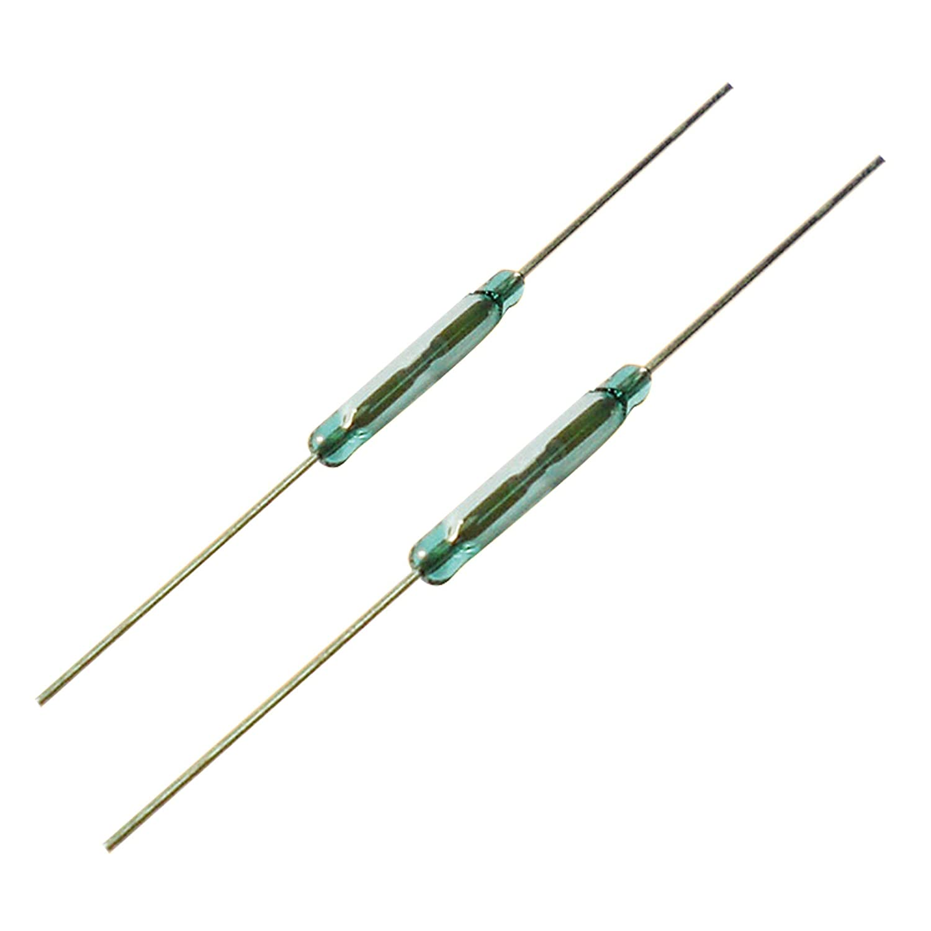
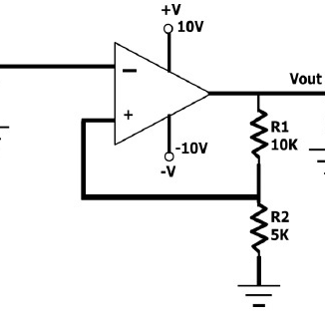
Rain Gauge Meter
Tipping bucker
Reed switch
Schmitt trigger
Including capacitors , resistors and microcontroller

